Slide 1
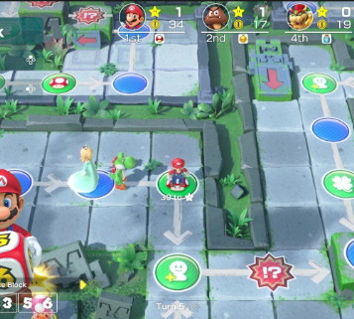
Game concept
Pitch
Liam

Slide 2
Isometric

Slide 3
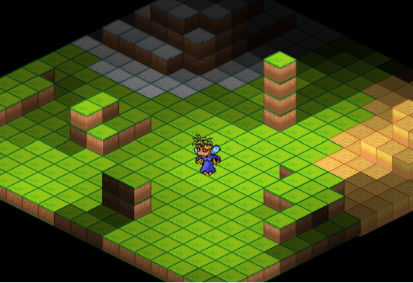
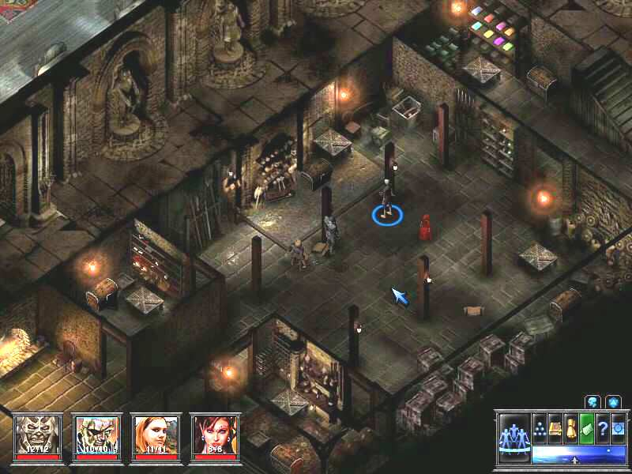
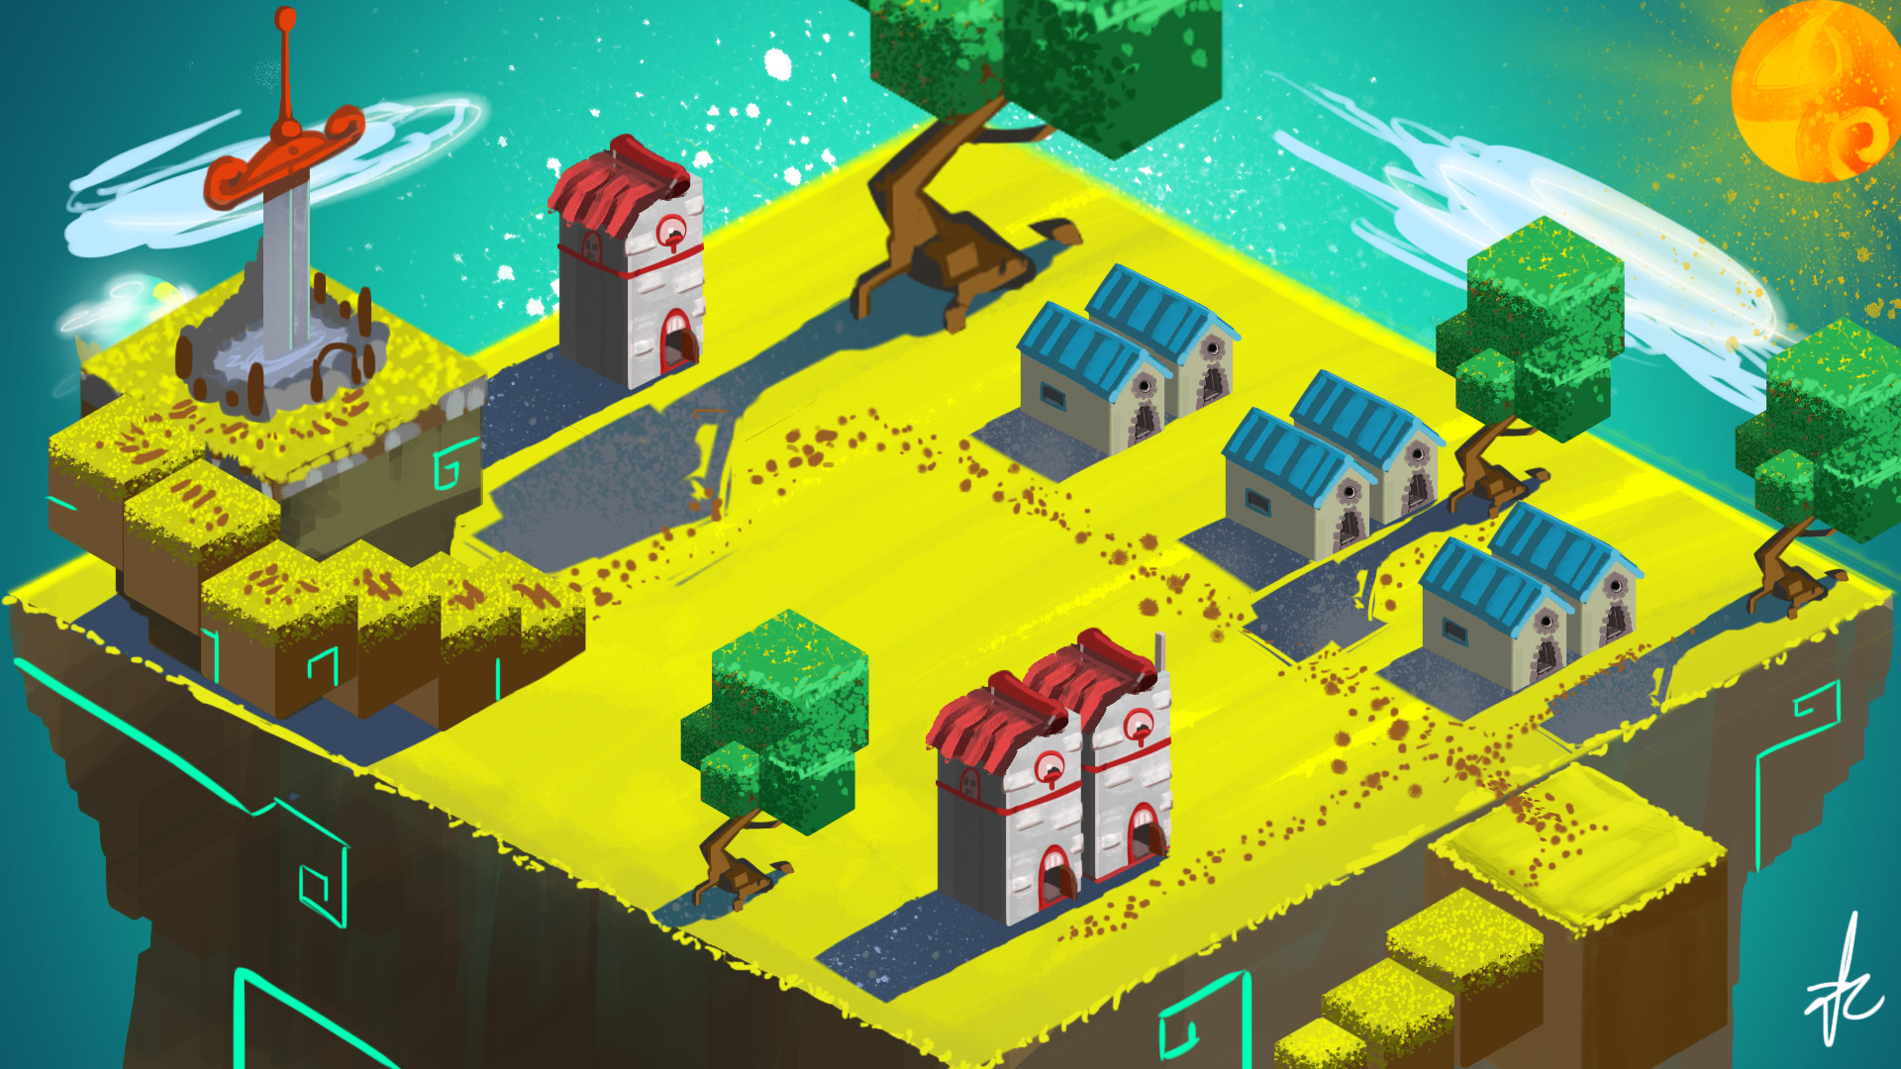
Creating an Isometric game
Consistent Pixel/Texel density - you only need to get the art detail to a certain point, and the detail is max and consistent.
Along with that, you don't need to worry about the camera being placed 2 inches from an object.
The amount of the game world on screen / in the view is fairly consistent
clipping objects to the view is usually easy
You can have very large game worlds by using tiles / repeating assets
Conversion between world space and screen space isn't that hard
Cons can include:
Limited options for lighting, etc in 2D
Sorting objects so everything looks correct.
Objects obscured by other objects in front of them need a solution or they can be lost by the player.

Slide 4
Achievements

Slide 5
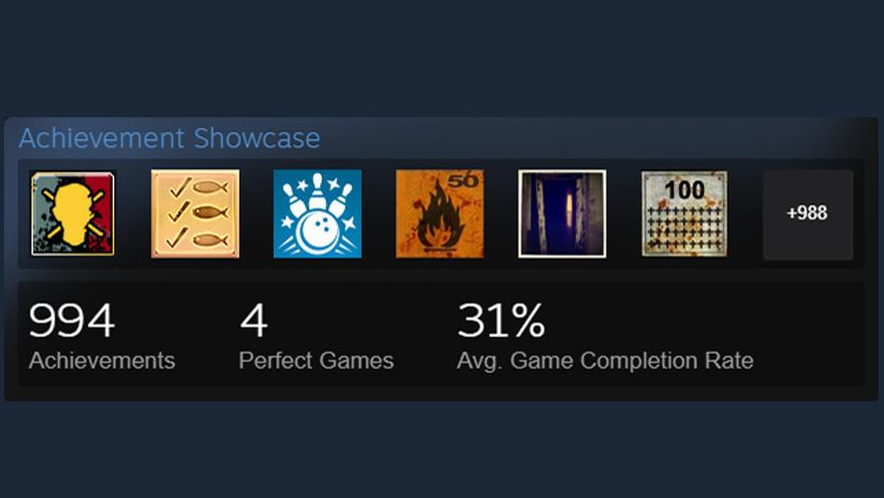
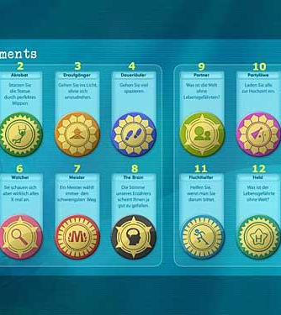
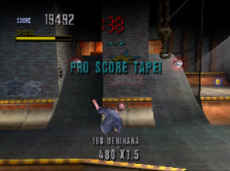

Slide 6
Mini Games

Slide 7
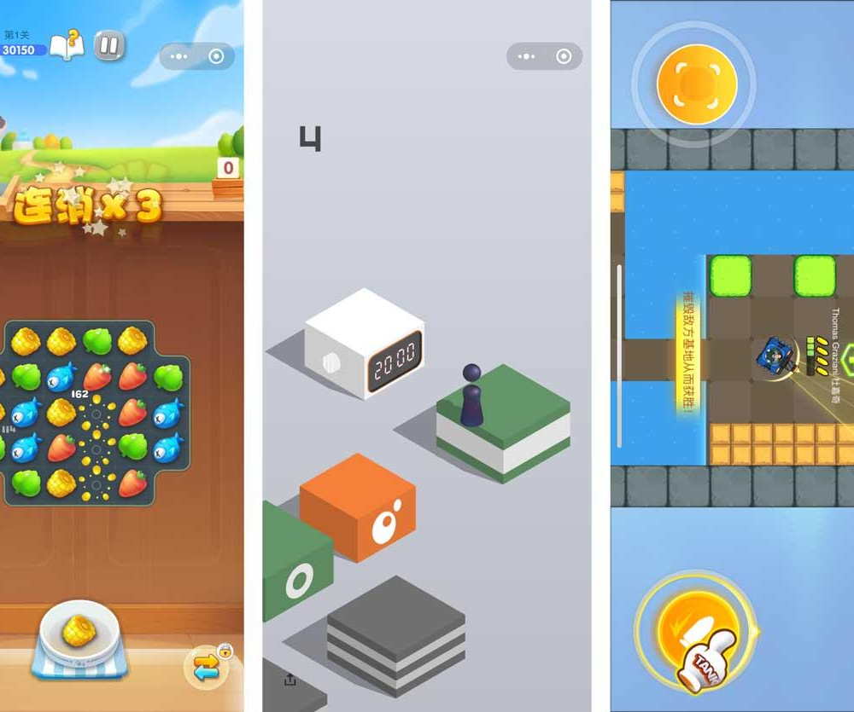
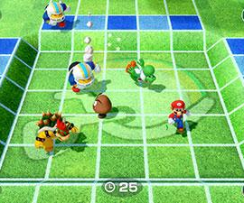
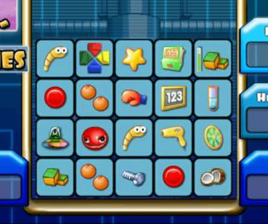

Slide 8
Intro video

Slide 9


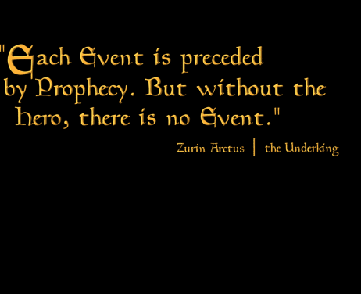

Slide 10

Phaser
Desktop and Mobile HTML5 game
framework.
A fast, free and fun open source framework for Canvas and WebGL powered browser games.

